Slide 1
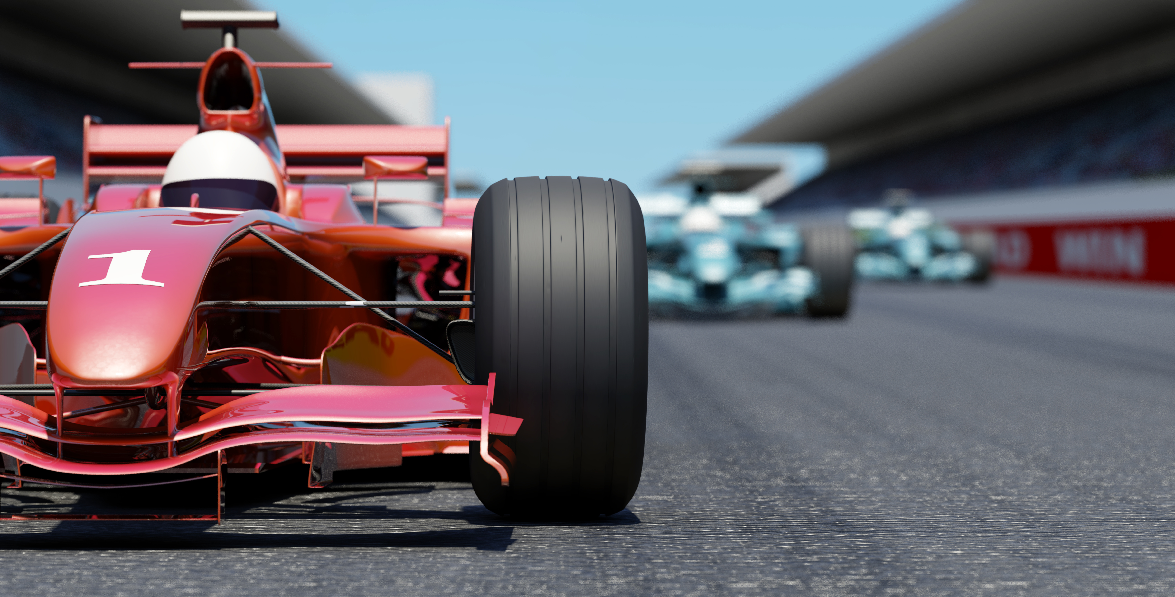
Race Your Rovers Capstone

Slide 2

Rules
Relay race – each member of a group drives the robot at least once.
Pick up one “Sample” at a time and Score at the “Basket”
Fastest Time Wins

